Slide 1


QML Lecture Series - 1
Intro to Quantum Machine Learning
https://cglink.me/22J/c38198591145025
Check in here!
Join us on SDC

Slide 2
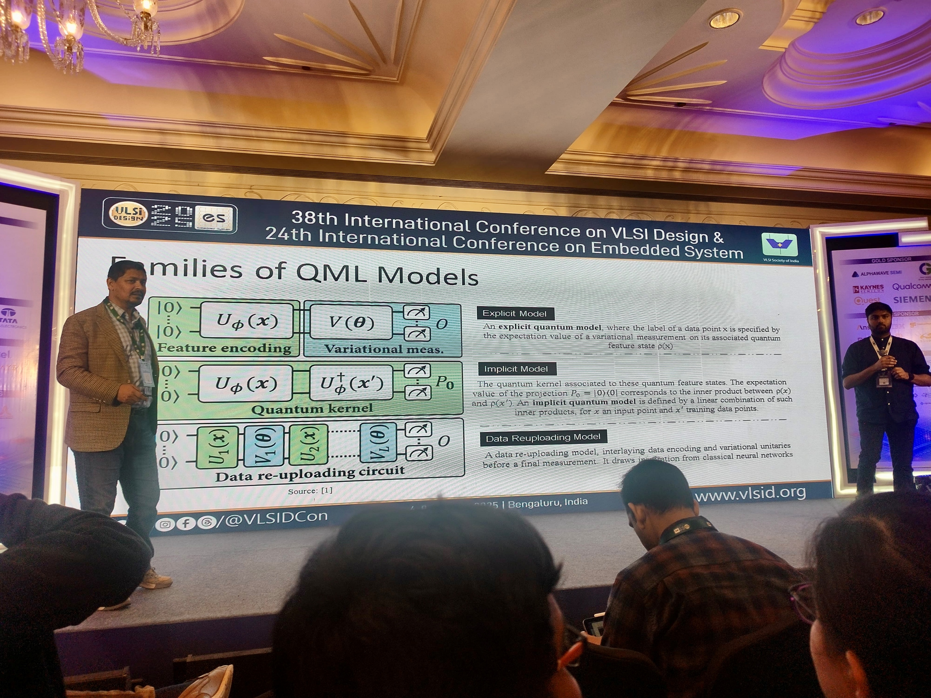

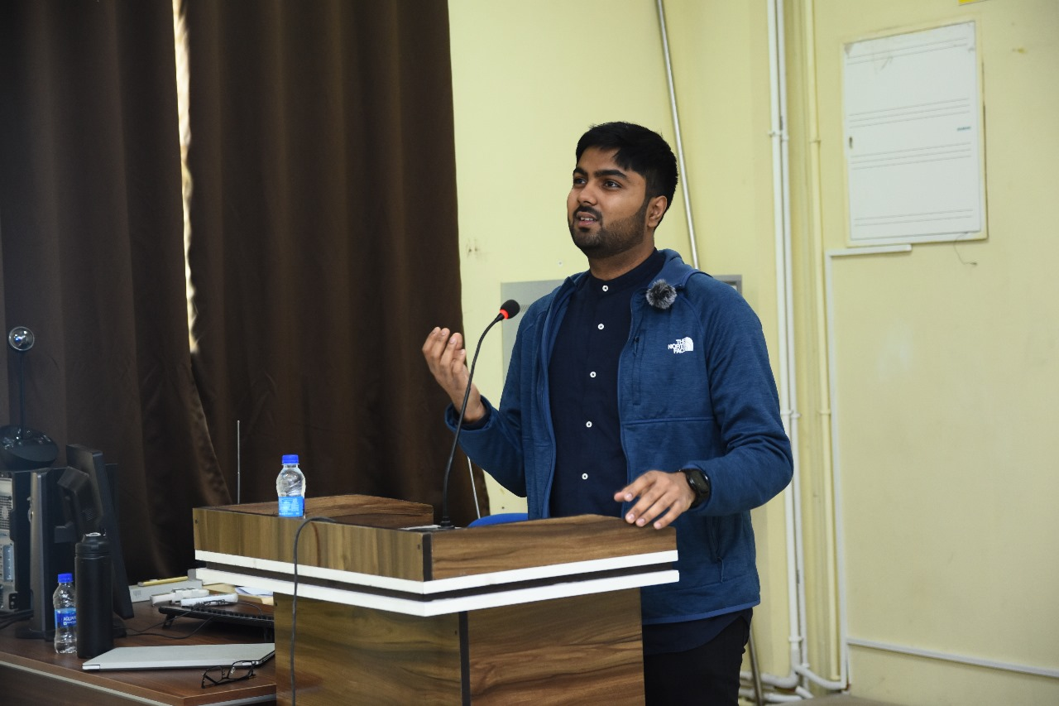
Presenter
Secretary
CSE 598
TA:
Spring 2025
Fall 2023
VLSI Conference,
Guest Speaker, 2024
Vinayak Sharma
Research Interests
Quantum Machine Learning
Representation Learning
ML for Science
PhD Student, MPS Lab
School of Computing and Augmented Intelligence,
NIT Rourkela,
Guest Speaker, 2024

Slide 3
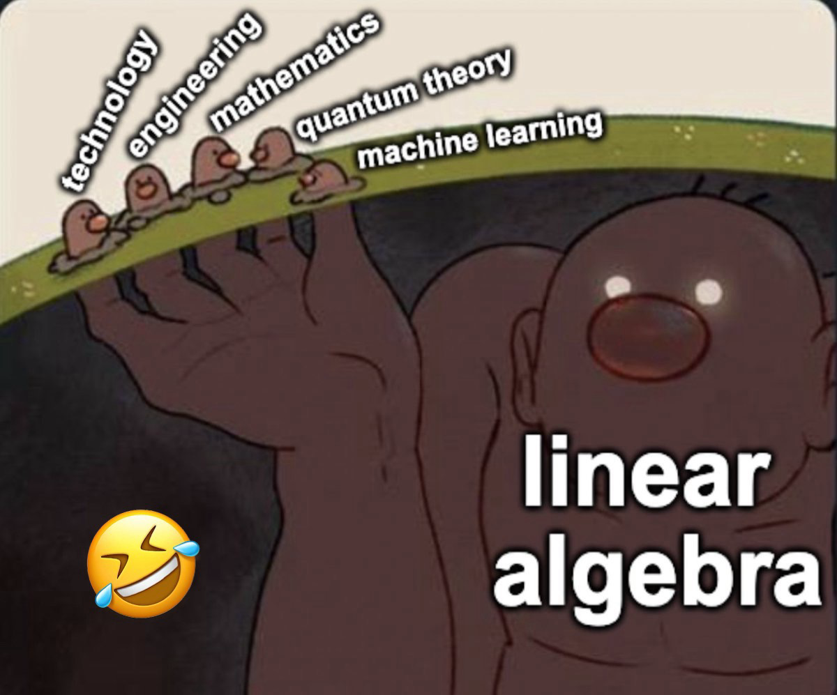
General Flow
Math Introduction
Vector Spaces
Complex Algebra
Quantum Computing
Qubits
Gates
Measurement
ML Fundamentals
Gradients
Training
QML Fundamentals
QML Gradients
QML Losses
QML Models
Variational
Data Re-Uploading
Kernel Based
Kernels
Probability Theory
Flow for how to approach QML. This is not the scope of today’s lecture but rather a general roadmap.

Slide 4

Why QML?
Hype $×$ Hype = Hype²
Setting the context

Slide 5
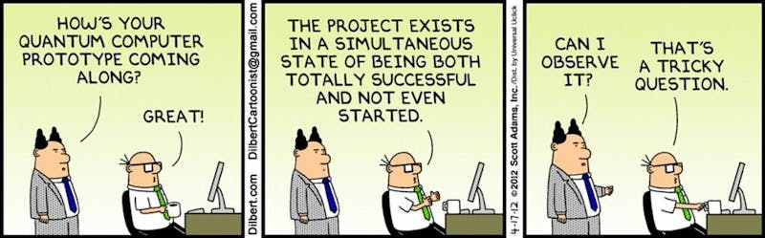
Starting with Quantum Computing
Quantum Computing
Quantum computing (QC) is a computational paradigm that leverages the principles of quantum mechanics to solve problems intractable for classical computers. It harnesses superposition and entanglement, allowing quantum bits (qubits) to exist in a probabilistic combination of 0 and 1 states. This enables exponentially larger state spaces compared to classical bits, enabling quantum algorithms to achieve speedups for specific computational tasks.
Computer Science
Physics
Math
The elephant in the room….
Most quantum computers today are still very limited, leading to a large divide between the maturity of the software and the hardware.

Slide 6
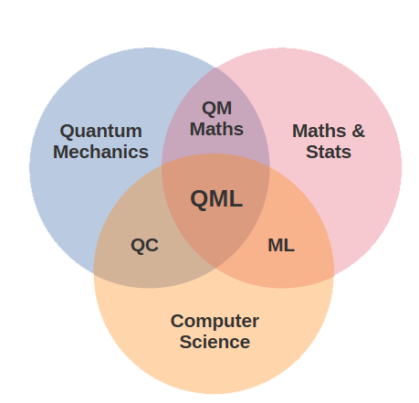
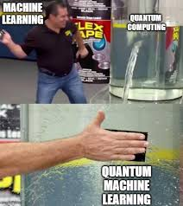
Enter QML…
The advantages of ML such as increased resistance to noise, help alleviate some of the challenges with NISQ devices.
Quantum Machine Learning (QML) is the field which combines Quantum Computing and Machine Learning to create a new class of models that efficiently exploit the advantages of Quantum Feature Space.

Slide 7
QML Practical Tools
How to get started

Slide 8






Tools of the Trade
My Preferred Stack
Other Known Tools
ML Stack
QC Stack
IBM Qiskit
Google Cirq

Slide 9

In case you missed it...
Check in here!
Join us on SDC
(So we can get you more yummy pizza)

Slide 10
QC Math
Building Blochs

Slide 11
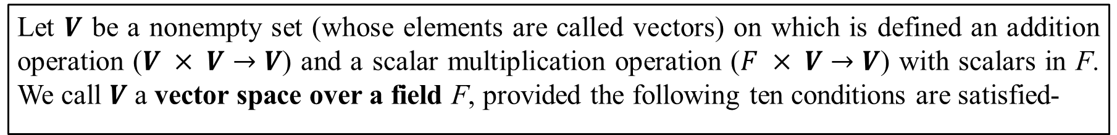
Vector Spaces
Math Definition
Let $V$ be a nonempty set (whose elements are called vectors) on which is defined an addition operation ($V × V→V$) and a scalar multiplication operation ($F × V→V$) with scalars in F. We call $V$ a vector space over a field F, provided the following ten conditions are satisfied-
A1. Closure under addition: For each pair of vectors u and v in V , the sum u + v is also in V . We say that V is closed under addition.
A2. Closure under scalar multiplication: For each vector v in V and each scalar k in F , the scalar multiple k v is also in V . We say that V is closed under scalar multiplication.
A3. Commutativity of addition: For all u, v ∈ V , we have u + v = v + u.
A4. Associativity of addition: For all u, v, w ∈ V , we have (u + v) + w = u + (v + w).
A5. Existence of a zero vector in V : In V there is a vector, denoted 0, satisfying v + 0 = v, for all v ∈ V.
A6. Existence of additive inverses in V : For each vector v ∈ V, there is a vector, denoted −v, in V such that v + (−v) = 0.
A7. Unit property: For all v ∈ V, 1v = v.
A8. Associativity of scalar multiplication: For all v ∈ V and all scalars r, s ∈ F , (rs)v = r(sv).
A9. Distributive property of scalar multiplication over vector addition: For all u, v ∈ V and all scalars r ∈ F , r(u + v) = ru + rv.
A10. Distributive property of scalar multiplication over scalar addition: For all v∈V and all scalars r,s ∈ F, (r + s)v = rv + sv.

Slide 12
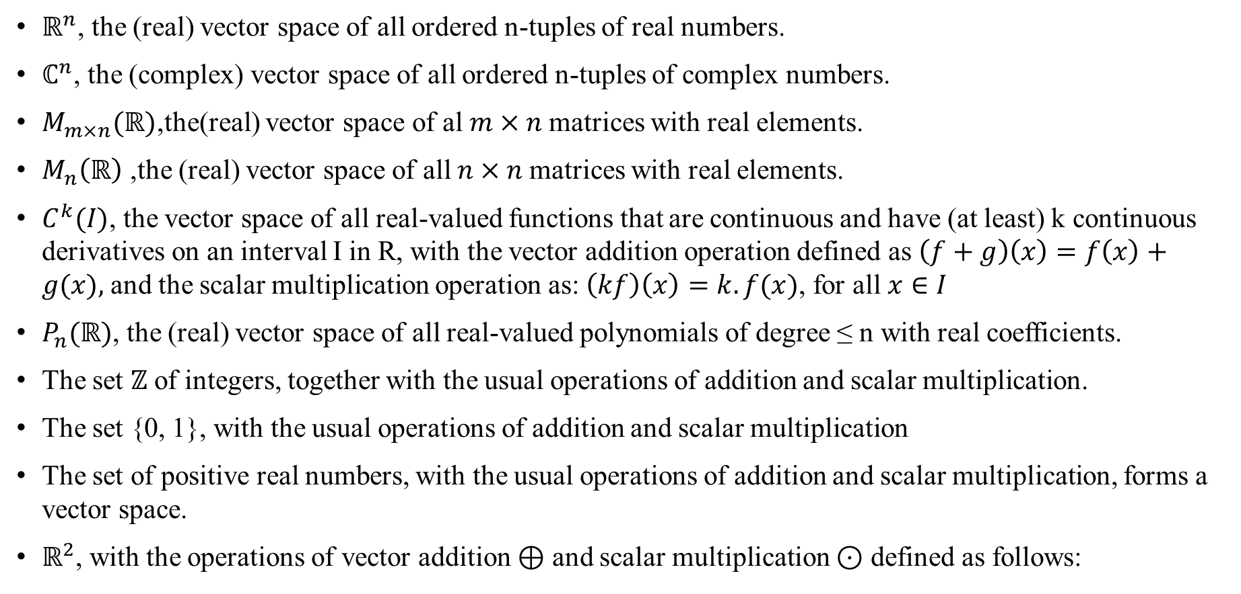
Vector Space Examples
$ℝ^{n}$, the (real) vector space of all ordered n-tuples of real numbers.
$ℂ^{n}$, the (complex) vector space of all ordered n-tuples of complex numbers.
$M_{m×n}(ℝ)$,the(real) vector space of al $m×n$matrices with real elements.
$M_{n}\left(ℝ\right)$ ,the (real) vector space of all $n×n$matrices with real elements.
$C^{k}(I)$, the vector space of all real-valued functions that are continuous and have (at least) k continuous derivatives on an interval I in R, with the vector addition operation defined as $\left(f+g\right)\left(x\right)=f\left(x\right)+g(x),$and the scalar multiplication operation as: $\left(kf\right)\left(x\right)=k.f(x)$, for all $x∈I$
$P_{n}(ℝ)$, the (real) vector space of all real-valued polynomials of degree ≤ n with real coefficients.
The set $ℤ$ of integers, together with the usual operations of addition and scalar multiplication.
The set {0, 1}, with the usual operations of addition and scalar multiplication
The set of positive real numbers, with the usual operations of addition and scalar multiplication, forms a vector space.
$ℝ^{2}$, with the operations of vector addition ⊕ and scalar multiplication ⊙ defined as follows:

Slide 13
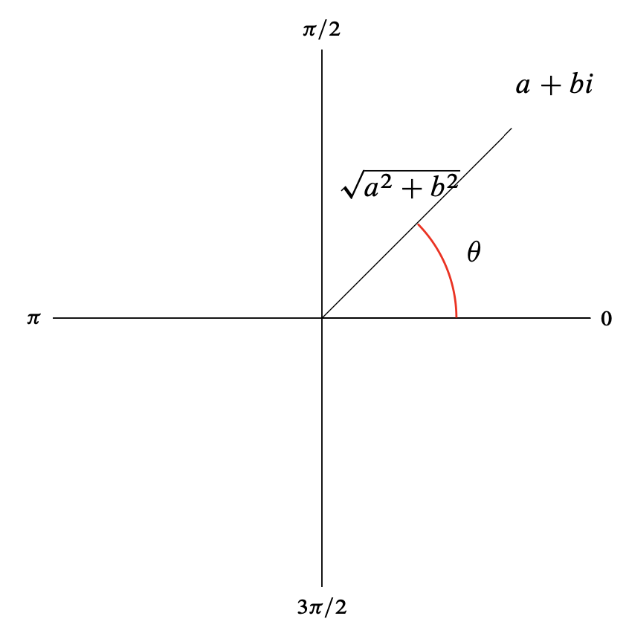
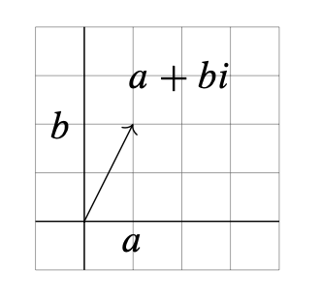
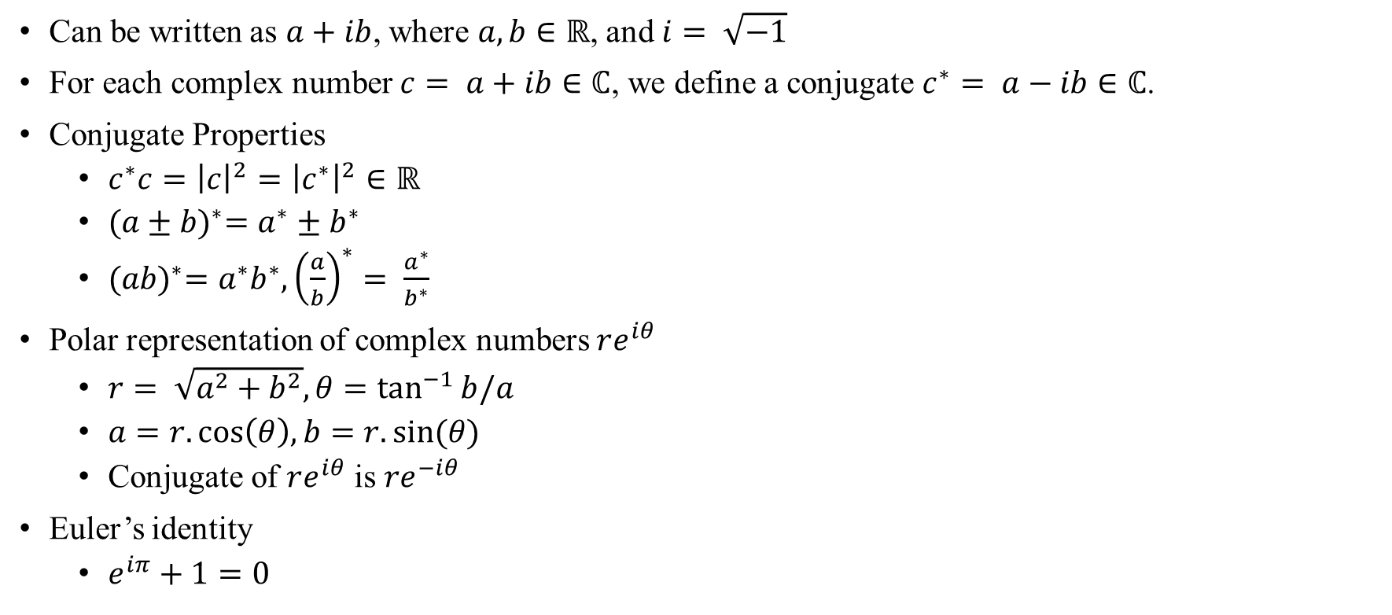
Complex Numbers
Can be written as $a+ib$, where $a, b∈ℝ$, and $i= \sqrt{−1}$
For each complex number $c= a+ib∈ℂ$, we define a conjugate $c^{∗}= a−ib∈ℂ$.
Conjugate Properties
$c^{∗}c={\left|c\right|}^{2}={\left|c^{∗}\right|}^{2}∈ℝ$
${(a±b)}^{∗}=a^{∗}±b^{∗}$
${(ab)}^{∗}=a^{∗}b^{∗}, {\left(\frac{a}{b}\right)}^{∗}= \frac{a^{∗}}{b^{∗}}$
Polar representation of complex numbers $re^{iθ}$
$r= \sqrt{a^{2}+b^{2}}, θ=\tan^{−1}{b/a}$
$a=r.\cos\left(θ\right), b=r.sin⁡(θ)$
Conjugate of $re^{iθ}$ is $re^{−iθ}$
Euler’s identity
$e^{iπ}+1=0$

